Slide 1











23ECE285 Machine learning laboratory
INTRODUCTION
PROBLEM STATEMENT
LITERATURE SURVEY
MOTIVATION AND OBJECTIVES
METHODOLOGY
RESULTS AND DISCUSSION
MILESTONES ACHIEVED
REFERENCES
CONTENTS
Smart Inventory Optimization using Machine Learning Algorithms
NAVEEN SARVAN KUMAR - CB.EN.U4ECE23232
RAHUL KRISHNA J -CB.EN.U4ECE23238
SRINIVAS NV -CB.EN.U4ECE23247
INTRODUCTION
PROBLEM STATEMENT
LITERATURE SURVEY
MOTIVATION AND OBJECTIVES
METHODOLOGY
RESULTS AND DISCUSSION
MILESTONES ACHIEVED
REFERENCES
This Photo by Unknown Author is licensed under CC BY
CONTENTS

Slide 2

CONTENTS
Inventory management plays a crucial role in supply chain operations.
The global pandemic disrupted inventory systems, increasing demand for intelligent solutions.
Machine Learning (ML) techniques provide efficient ways to optimize inventory management.
This study applies ML algorithms to classify inventory using the ABC Classification method.
CONTENTS
INTRODUCTION
PROBLEM STATEMENT
LITERATURE SURVEY
MOTIVATION AND OBJECTIVES
METHODOLOGY
RESULTS AND DISCUSSION
ADDITIONAL WORK DONE
OVERALL ANALYSIS
MILESTONES ACHIEVED
SUMMARY
REFERENCES
INTRODUCTION
Inventory management plays a crucial role in supply chain operations.
The global pandemic disrupted inventory systems, increasing demand for intelligent solutions.
Machine Learning (ML) techniques provide efficient ways to optimize inventory management.
This study applies ML algorithms to classify inventory using the ABC Classification method.
PROBLEM STATEMENT
During the global health crisis , businesses faced unprecedented challenges in managing their inventory due to disruptions in transportation, manufacturing delays, and sudden shifts in consumer demand.

Slide 3
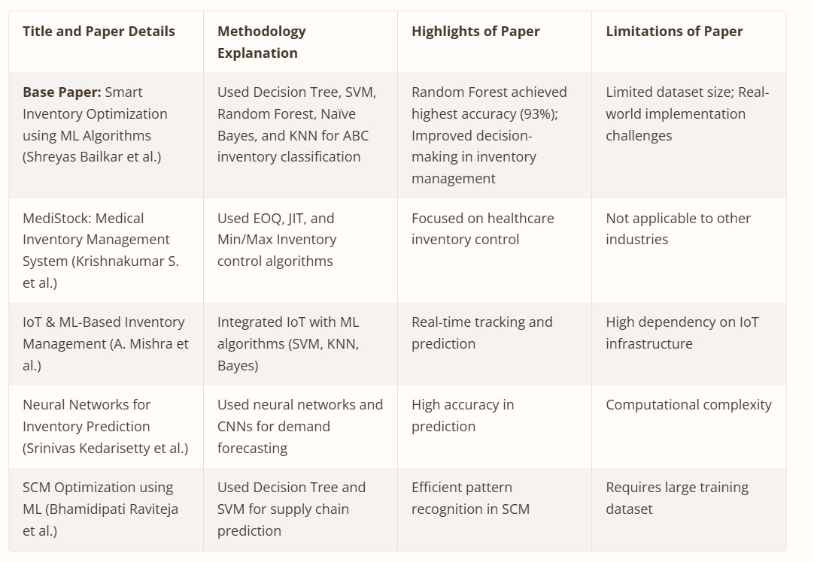
INTRODUCTION
PROBLEM STATEMENT
Inventory management plays a crucial role in supply chain operations.
The global pandemic disrupted inventory systems, increasing demand for intelligent solutions.
Machine Learning (ML) techniques provide efficient ways to optimize inventory management.
This study applies ML algorithms to classify inventory using the ABC Classification method.
PROBLEM STATEMENT
During the global health crisis , businesses faced unprecedented challenges in managing their inventory due to disruptions in transportation, manufacturing delays, and sudden shifts in consumer demand . Hence , we develop a ML Model to optimize inventory
1
During the global health crisis , businesses faced unprecedented challenges in managing their inventory due to disruptions in transportation, manufacturing delays, and sudden shifts in consumer demand. Essential items experienced stock depletion, while non-essential goods led to increased holding costs. Traditional inventory management approaches lacked the adaptability to handle such dynamic conditions effectively and operations efficiently.

Slide 4


LITERATURE SURVEY
Smart Inventory Optimization using ML Algorithms (Shreyas Bailkar)
Methodology:
Implemented five ML classifiers—Decision Tree, SVM, Random Forest, KNN, and Naïve Bayes—for ABC inventory classification.
Highlights:
Random Forest achieved the highest accuracy of 93%, demonstrating its effectiveness in inventory categorization.
Improved decision-making for inventory control by classifying items into high, medium, and low priority.
Limitations:
The dataset used was relatively small, potentially affecting model generalizability.
Real-world implementation challenges, such as dynamic demand fluctuations, were not extensively addressed.
The main objective is or the paper focuses on using Machine Learning (ML) algorithms to optimize inventory management. It specifically employs the ABC Classification methodology to categorize inventory items based on their importance, cost, and perishability (otherwise shelf life as mentioned in base paper).
Machine Learning Algorithms Used:
The study evaluates five ML algorithms for inventory classification:
Naïve Bayes
Support Vector Machines (SVM)
K-Nearest Neighbors (KNN)
Decision Tree Classifier
Random Forest Classifier
2
Smart Inventory Optimization using ML Algorithms (Shreyas Bailkar)
Methodology:
Implemented five ML classifiers—Decision Tree, SVM, Random Forest, KNN, and Naïve Bayes—for ABC inventory classification.
Highlights:
Random Forest achieved the highest accuracy of 93%, demonstrating its effectiveness in inventory categorization.
Improved decision-making for inventory control by classifying items into high, medium, and low priority.
Limitations:
The dataset used was relatively small, potentially affecting model generalizability.
Real-world implementation challenges, such as dynamic demand fluctuations, were not extensively addressed.

Slide 5
3

Slide 6
MOTIVATION
The study highlights the importance of ABC Classification as a fundamental inventory management technique, especially in unpredictable demand scenarios such as those caused by the COVID-19 pandemic.
The motivation behind implementing ABC Classification using Machine Learning (ML) algorithms is to: Improve inventory management efficiency by prioritizing high-value and high-priority items.
3.4 Neural Networks for Inventory Prediction (Srinivas Kedarisetty et al.)
Methodology: Used deep learning models, including Convolutional Neural Networks (CNNs) and Artificial Neural Networks (ANNs), for demand forecasting.
Highlights:
Achieved high accuracy in demand prediction using advanced neural networks.
Enhanced forecasting capabilities compared to traditional statistical methods.
Limitations:
Computational complexity made real-time deployment challenging.
Required a large volume of high-quality historical data for effective training.
4

Slide 7
OBJECTIVES :
Compare different ML algorithms (KNN, SVM, Decision Tree, Naïve Bayes, and Random Forest) to determine the most accurate classification method.
Apply Pareto's 80/20 rule to classify inventory efficiently and prioritize high-value items for better stock control.
5
1
DATA COLLECTION AND PREPROCESSING
2
MACHINE LEARNING MODEL SELECTION AND TRAINING
3
ABC CLASSIFICATION IMPLEMENTATION
MODEL EVALUATION AND PERFORMANCE ANALYSIS
1
DATA COLLECTION AND PREPROCESSING
2
MACHINE LEARNING MODEL SELECTION AND TRAINING
3
ABC CLASSIFICATION IMPLEMENTATION
MODEL EVALUATION AND PERFORMANCE ANALYSIS

Slide 8
METHODOLOGY :
1
DATA COLLECTION AND PREPROCESSING
2
MACHINE LEARNING MODEL SELECTION AND TRAINING
3
ABC CLASSIFICATION IMPLEMENTATION
MODEL EVALUATION AND PERFORMANCE ANALYSIS
6
1
DATA COLLECTION AND PREPROCESSING
2
MACHINE LEARNING MODEL SELECTION AND TRAINING
3
ABC CLASSIFICATION IMPLEMENTATION
MODEL EVALUATION AND PERFORMANCE ANALYSIS

Slide 9
1
DATA COLLECTION AND PREPROCESSING
Stock level (quantity available)
Demand frequency (historical demand trends)
Cost per unit (high-cost vs. low-cost items)
Perishability (shelf life of products)
Lead time (time taken for stock replenishment)
Data cleaning techniques such as handling missing values and outliers are applied.
Feature scaling is performed to standardize numerical attributes.
7
1
DATA COLLECTION AND PREPROCESSING
2
MACHINE LEARNING MODEL SELECTION AND TRAINING
3
ABC CLASSIFICATION IMPLEMENTATION
MODEL EVALUATION AND PERFORMANCE ANALYSIS

Slide 10
1
ABC CLASSIFICATION IMPLEMENTATION
The ABC classification model is implemented to categorize inventory items based on their importance:
Class A: High-value, low-quantity items (high-priority)
Class B: Moderate-value, moderate-quantity items
Class C: Low-value, high-quantity items (low-priority)
This classification is done based on parameters such as annual consumption value and demand fluctuations.
8
1
DATA COLLECTION AND PREPROCESSING
2
MACHINE LEARNING MODEL SELECTION AND TRAINING
3
ABC CLASSIFICATION IMPLEMENTATION
MODEL EVALUATION AND PERFORMANCE ANALYSIS

Slide 11
2
MACHINE LEARNING MODEL SELECTION AND TRAINING
The study explores five machine learning classification algorithms for inventory optimization:
Naïve Bayes Algorithm:
A probabilistic classifier based on Bayes’ theorem.
Assumes independence between features.
Used for its simplicity and fast computation.
Support Vector Machines (SVM):
Finds the optimal hyperplane for classification.
Works well with high-dimensional datasets.
In this study, SVM performed poorly (40% accuracy) due to non-linearity in inventory data.
9
1
DATA COLLECTION AND PREPROCESSING
2
MACHINE LEARNING MODEL SELECTION AND TRAINING
3
ABC CLASSIFICATION IMPLEMENTATION
MODEL EVALUATION AND PERFORMANCE ANALYSIS

Slide 12
2
MACHINE LEARNING MODEL SELECTION AND TRAINING
K-Nearest Neighbors (KNN):
Classifies items based on their similarity to nearest neighbors.
Works well for small datasets but struggled with larger datasets in this study.
Decision Tree Algorithm:
A tree-based model that splits data based on decision rules.
Simple and interpretable but prone to overfitting.
Random Forest Classifier:
An ensemble method that uses multiple decision trees.
Achieved the highest accuracy (93%) in classifying inventory items.
Reduces overfitting compared to a single decision tree.
The dataset is split into training (80%) and testing (20%) sets. Each algorithm is trained on the training set and tested for accuracy.
10
1
DATA COLLECTION AND PREPROCESSING
2
MACHINE LEARNING MODEL SELECTION AND TRAINING
3
ABC CLASSIFICATION IMPLEMENTATION
MODEL EVALUATION AND PERFORMANCE ANALYSIS

Slide 13
MODEL EVALUATION AND PERFORMANCE ANALYSIS
3
The models are evaluated using accuracy, precision, recall, and F1-score.
Confusion Matrix is used to analyze classification performance.
Comparison of ML models:
Random Forest: 93% accuracy (best model)
Decision Tree: 87% accuracy
Naïve Bayes: 74% accuracy
KNN: 54% accuracy
SVM: 40% accuracy (least effective)
11
Performance Analysis of Machine Learning Models
The base paper evaluates the effectiveness of different machine learning classifiers in optimizing inventory management using the ABC classification model. The models were tested on a dataset containing stock-keeping units (SKUs) with various attributes such as demand frequency, perishability, cost, and lead time.
The classification results of the models were compared based on accuracy, precision, recall, and F1-score. Below is a breakdown of their performance:

Slide 14
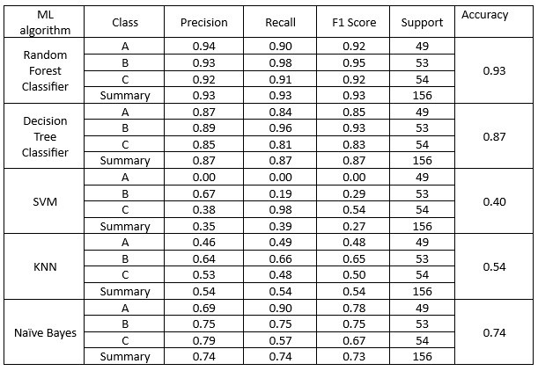
RESULTS AND DISCUSSIONS :
Performance Analysis of Machine Learning Models
The base paper evaluates the effectiveness of different machine learning classifiers in optimizing inventory management using the ABC classification model. The models were tested on a dataset containing stock-keeping units (SKUs) with various attributes such as demand frequency, perishability, cost, and lead time.
The classification results of the models were compared based on accuracy, precision, recall, and F1-score. Below is a breakdown of their performance:
12

Slide 15
Models | Optimized Parameters | Expected Accuracy | Obtained Accuracy
Random Forest | n_estimators: 463 max_depth: 24 | 0.93 | 0.91
Decision Tree | max_depth: 41 min_samples_split: 13 min_samples_leaf: 4 | 0.87 | 0.88
SVM | C=0.01 gamma=10 kernel='poly' degree=10 | 0.40 | 0.38
KNN | n_neighbors=50 weights='distance' p=1 | 0.54 | 0.50
Naïve Bayes | var_smoothing: 0.04403762515730915 | 0.74 | 0.72

Slide 16
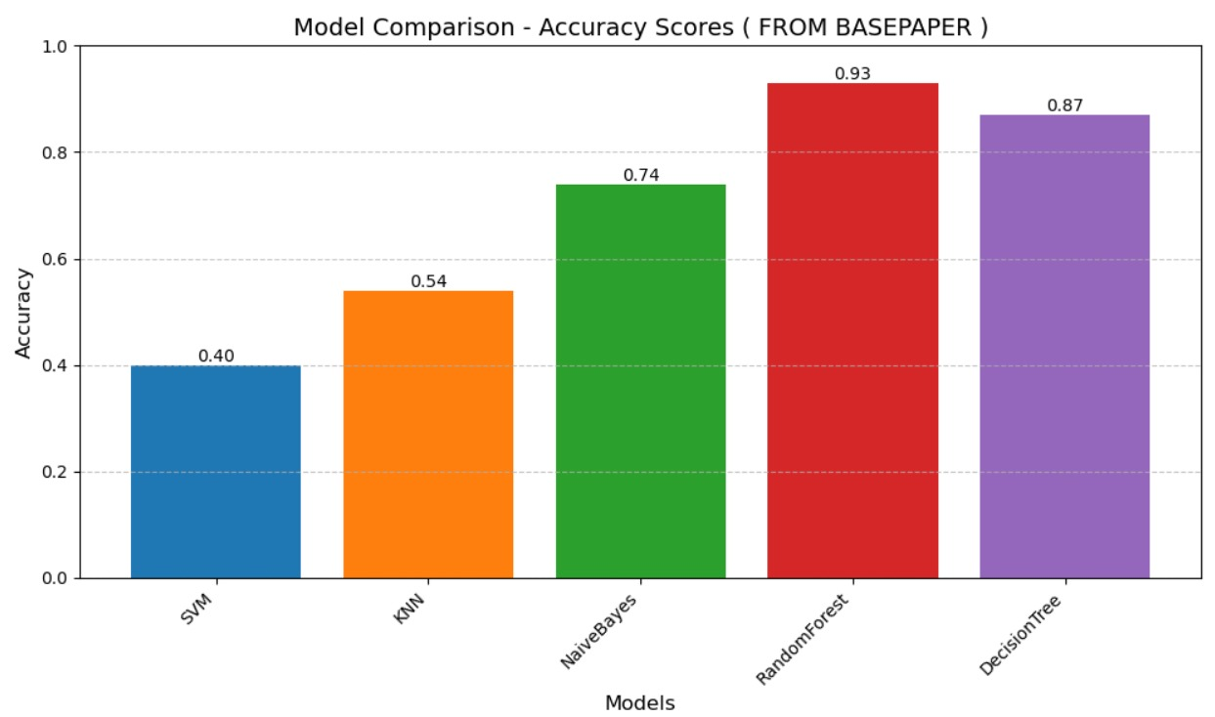
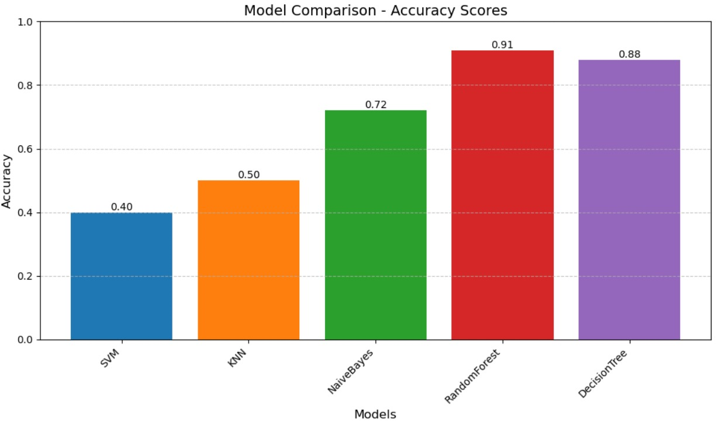
MODEL ACCURACY FROM CODE
0.38
14

Slide 17
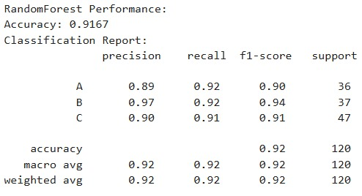
ACCURACY SCORES FROM BASE PAPER
ACCURACY SCORES FROM CODE
15
JAN 21 TO JAN 31
Topic and base paper finalization
FEB 10 TO FEB 14
STUDY OF BASE PAPER
FEB 17 TO FEB 21
IMPLEMENTATION STAGE 1
~DATA PREPROCESSING
~IMPUTATION
JAN 21 TO JAN 31
Topic and base paper finalization
FEB 10 TO FEB 14
STUDY OF BASE PAPER
FEB 17 TO FEB 21
IMPLEMENTATION STAGE 1
~DATA PREPROCESSING
~IMPUTATION

Slide 18
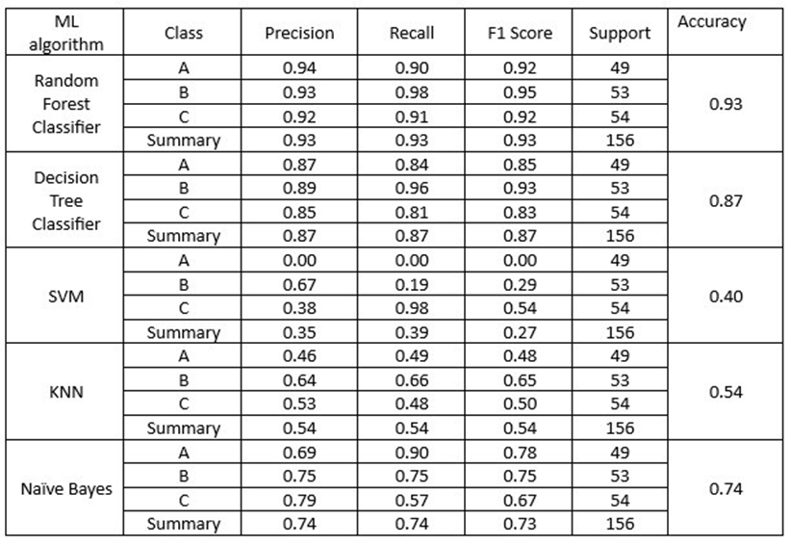
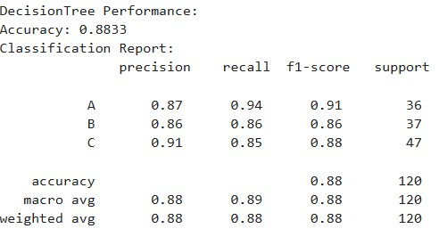
ACCURACY SCORES FROM BASE PAPER
ACCURACY SCORES FROM CODE
16

Slide 19
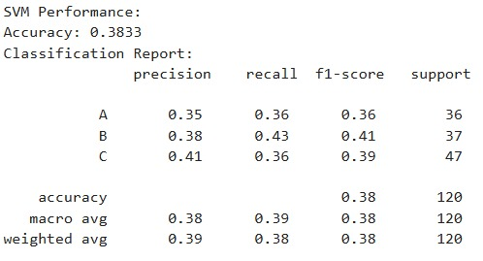
ACCURACY SCORES FROM BASE PAPER
ACCURACY SCORES FROM CODE
17

Slide 20
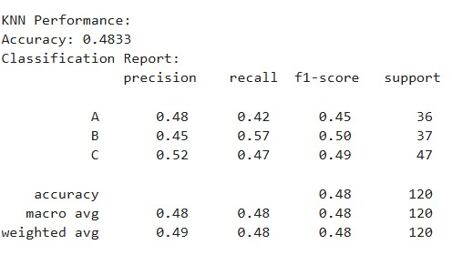
ACCURACY SCORES FROM BASE PAPER
ACCURACY SCORES FROM CODE
18

Slide 21
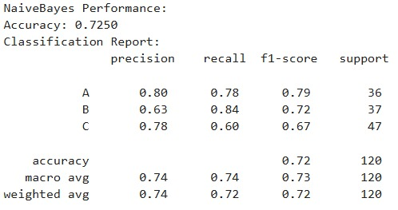
ACCURACY SCORES FROM BASE PAPER
ACCURACY SCORES FROM CODE
19

Slide 22
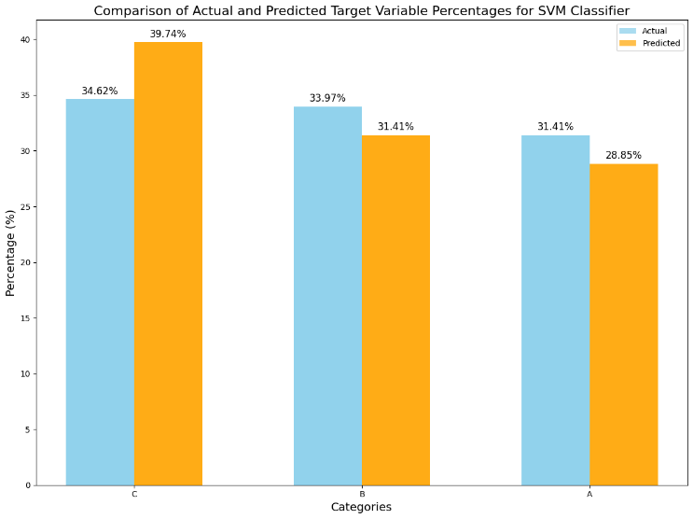
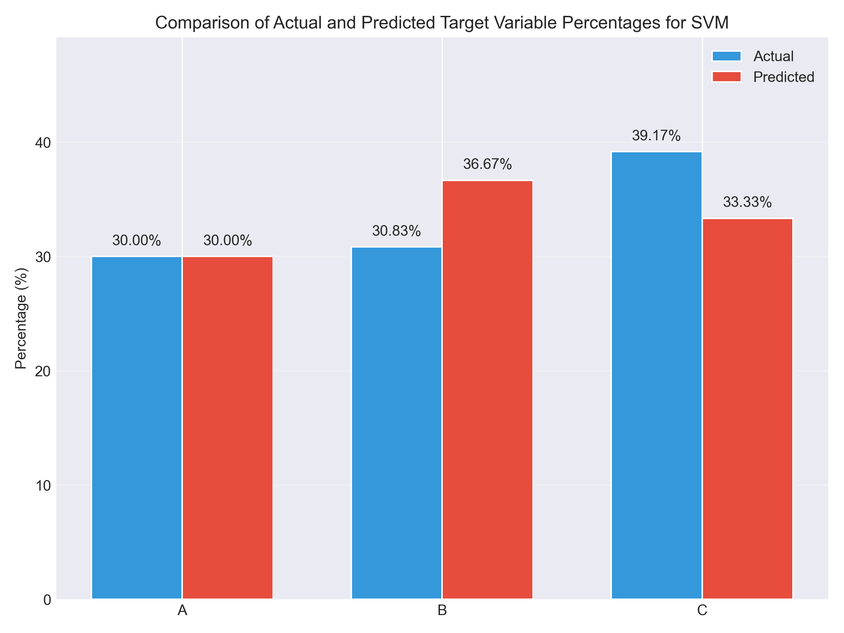
ACCURACY SCORE OF SVM :
ACCURACY SCORES FROM BASE PAPER
ACCURACY SCORES FROM CODE
20

Slide 23
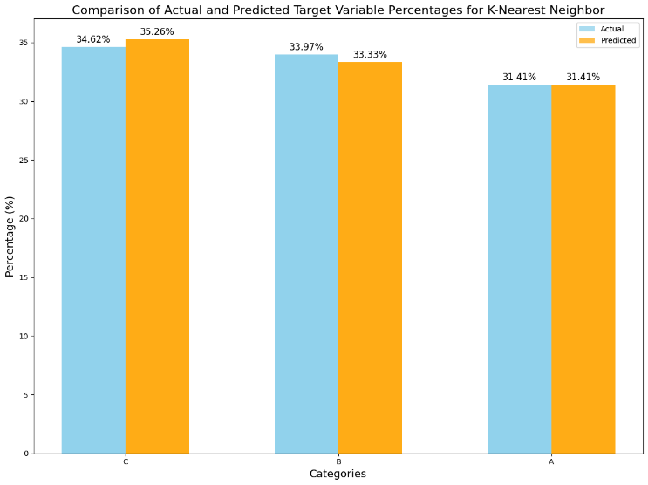
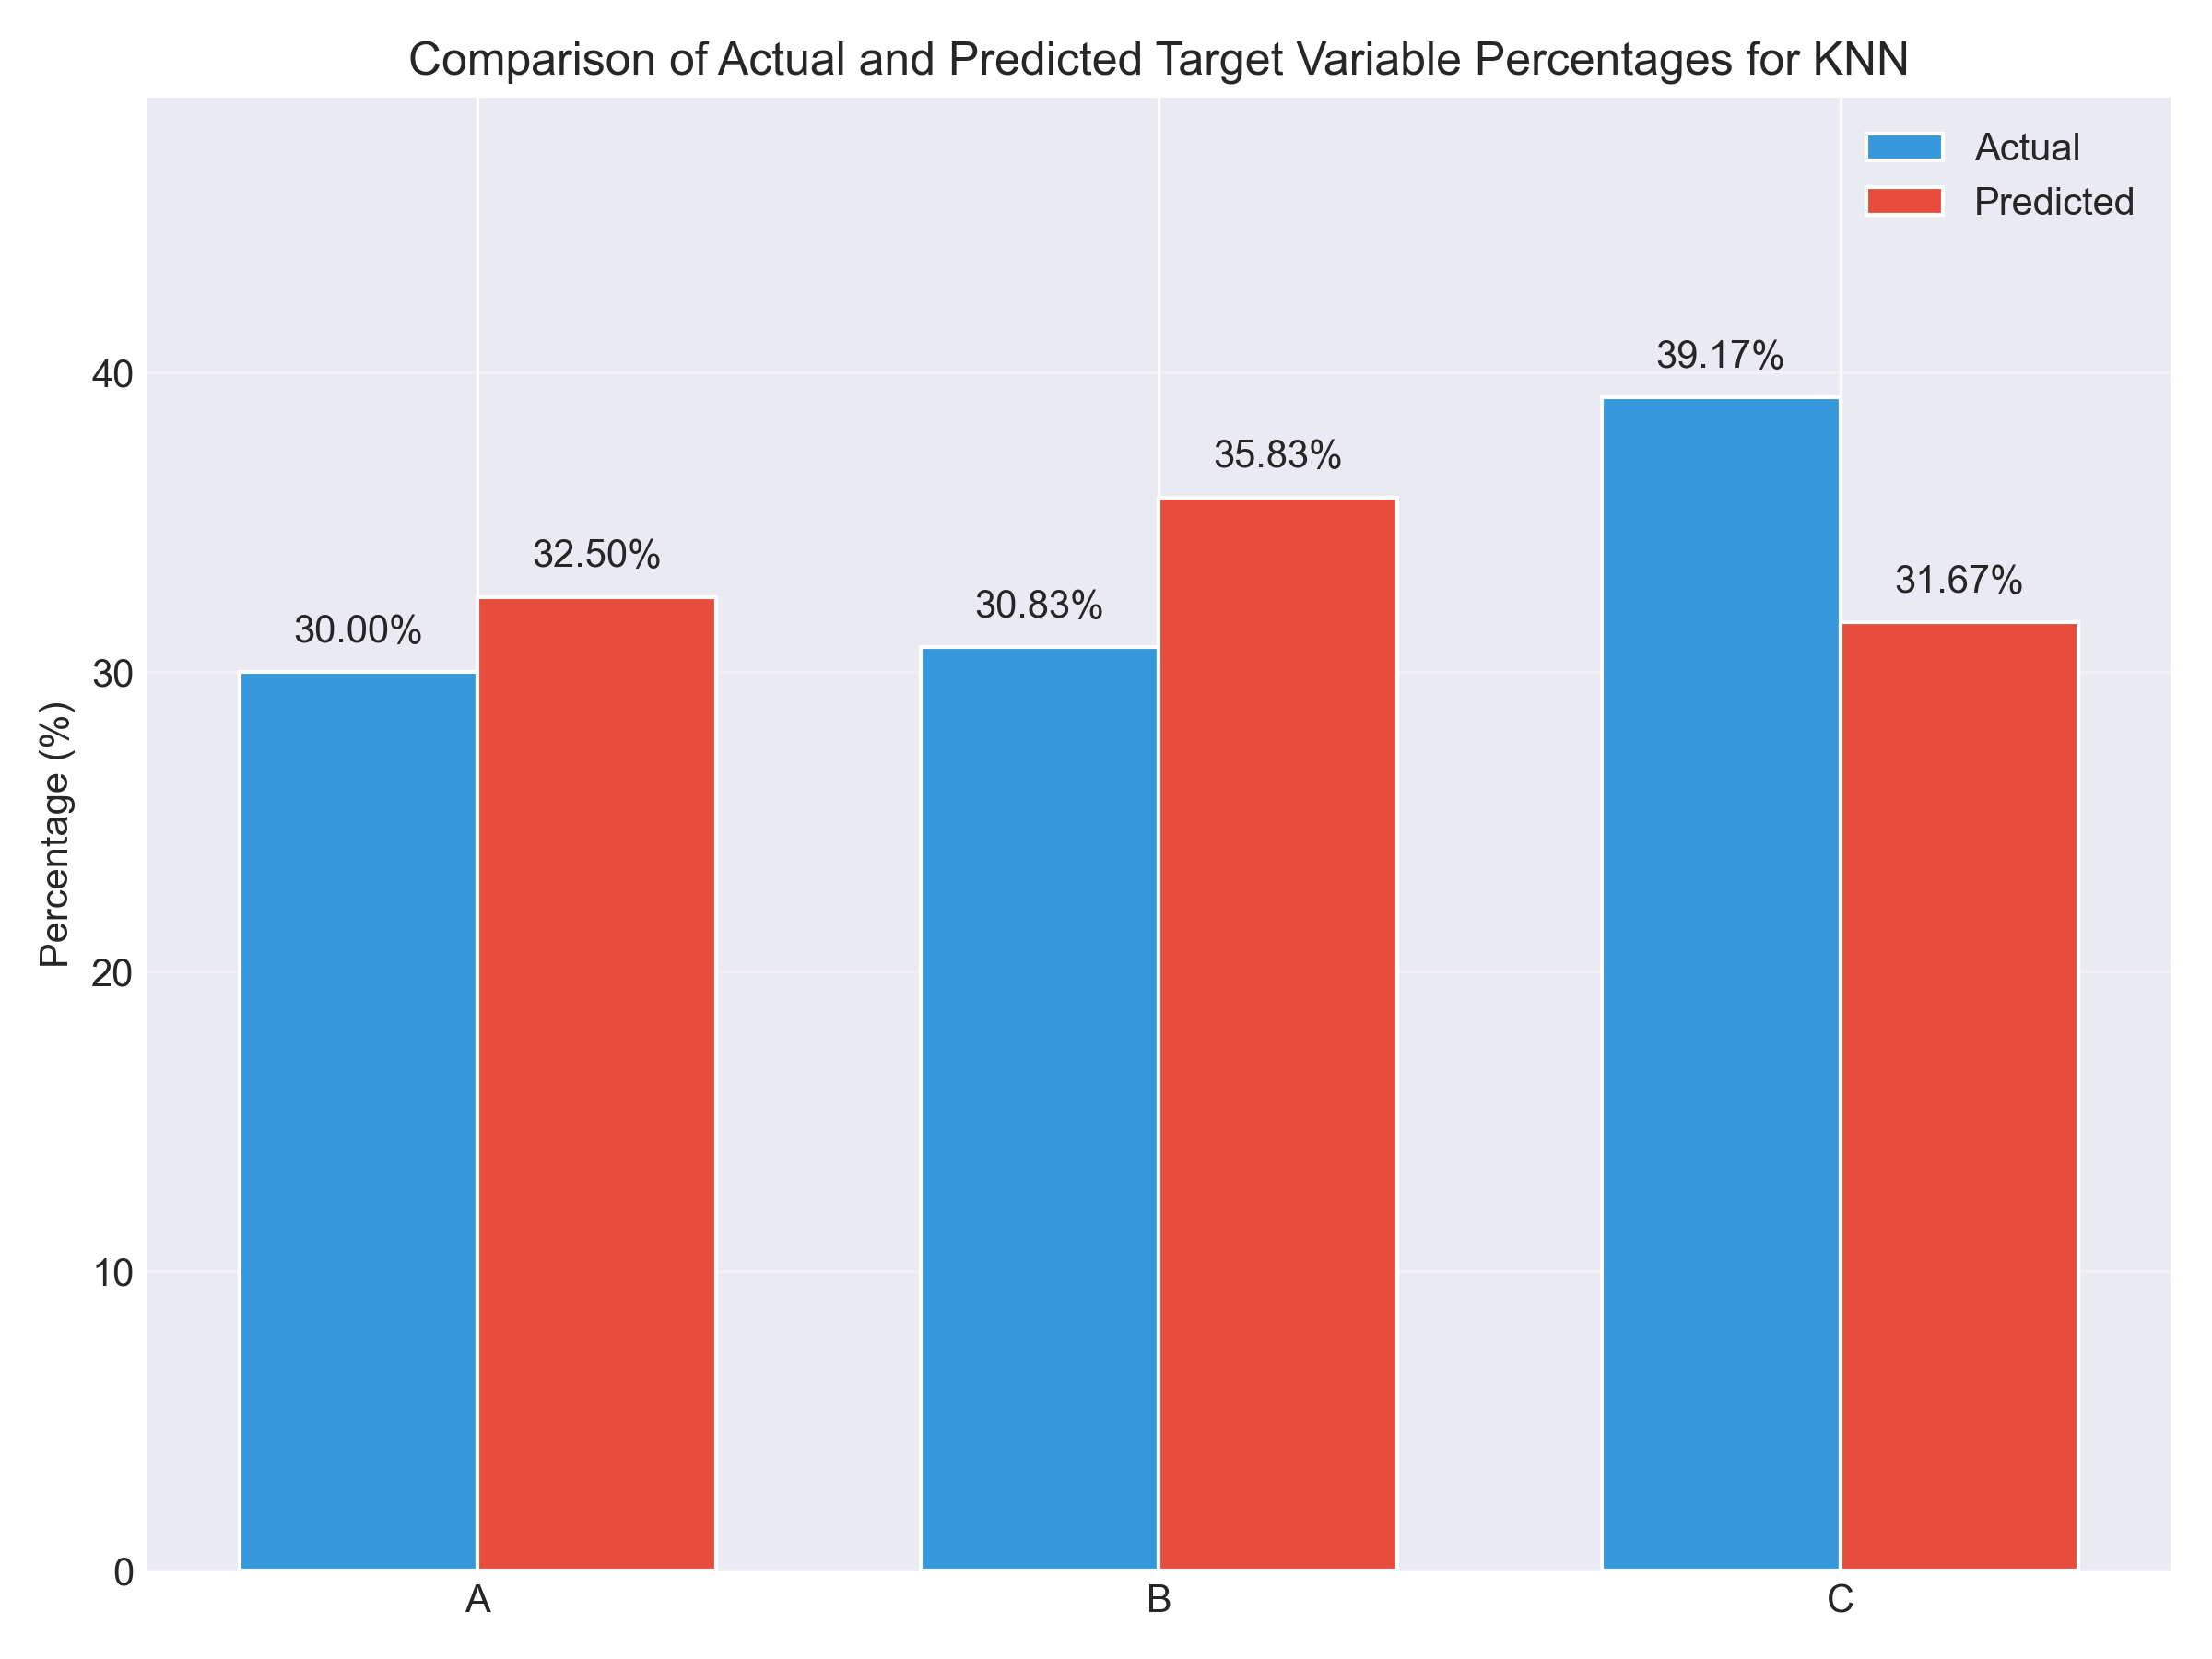
ACCURACY SCORE OF KNN :
ACCURACY SCORES FROM BASE PAPER
ACCURACY SCORES FROM CODE
21

Slide 24
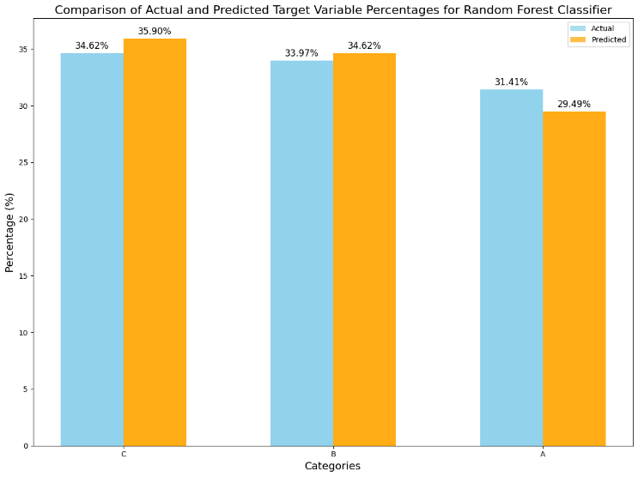
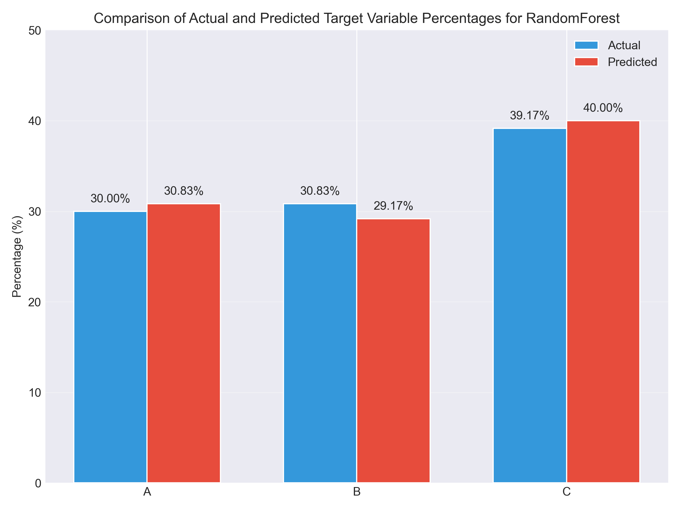
ACCURACY SCORE OF RANDOM FOREST :
ACCURACY SCORES FROM BASE PAPER
ACCURACY SCORES FROM CODE
22

Slide 25
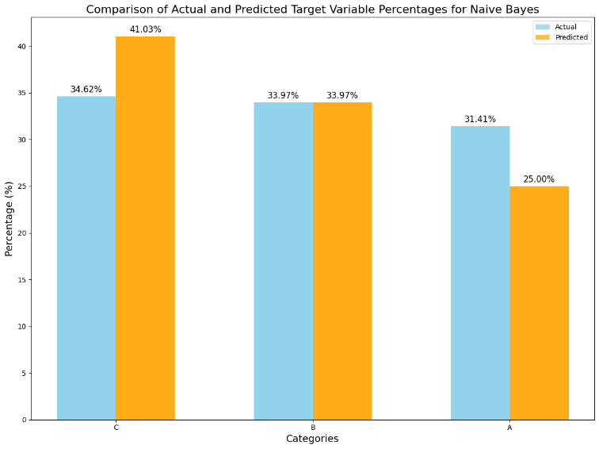
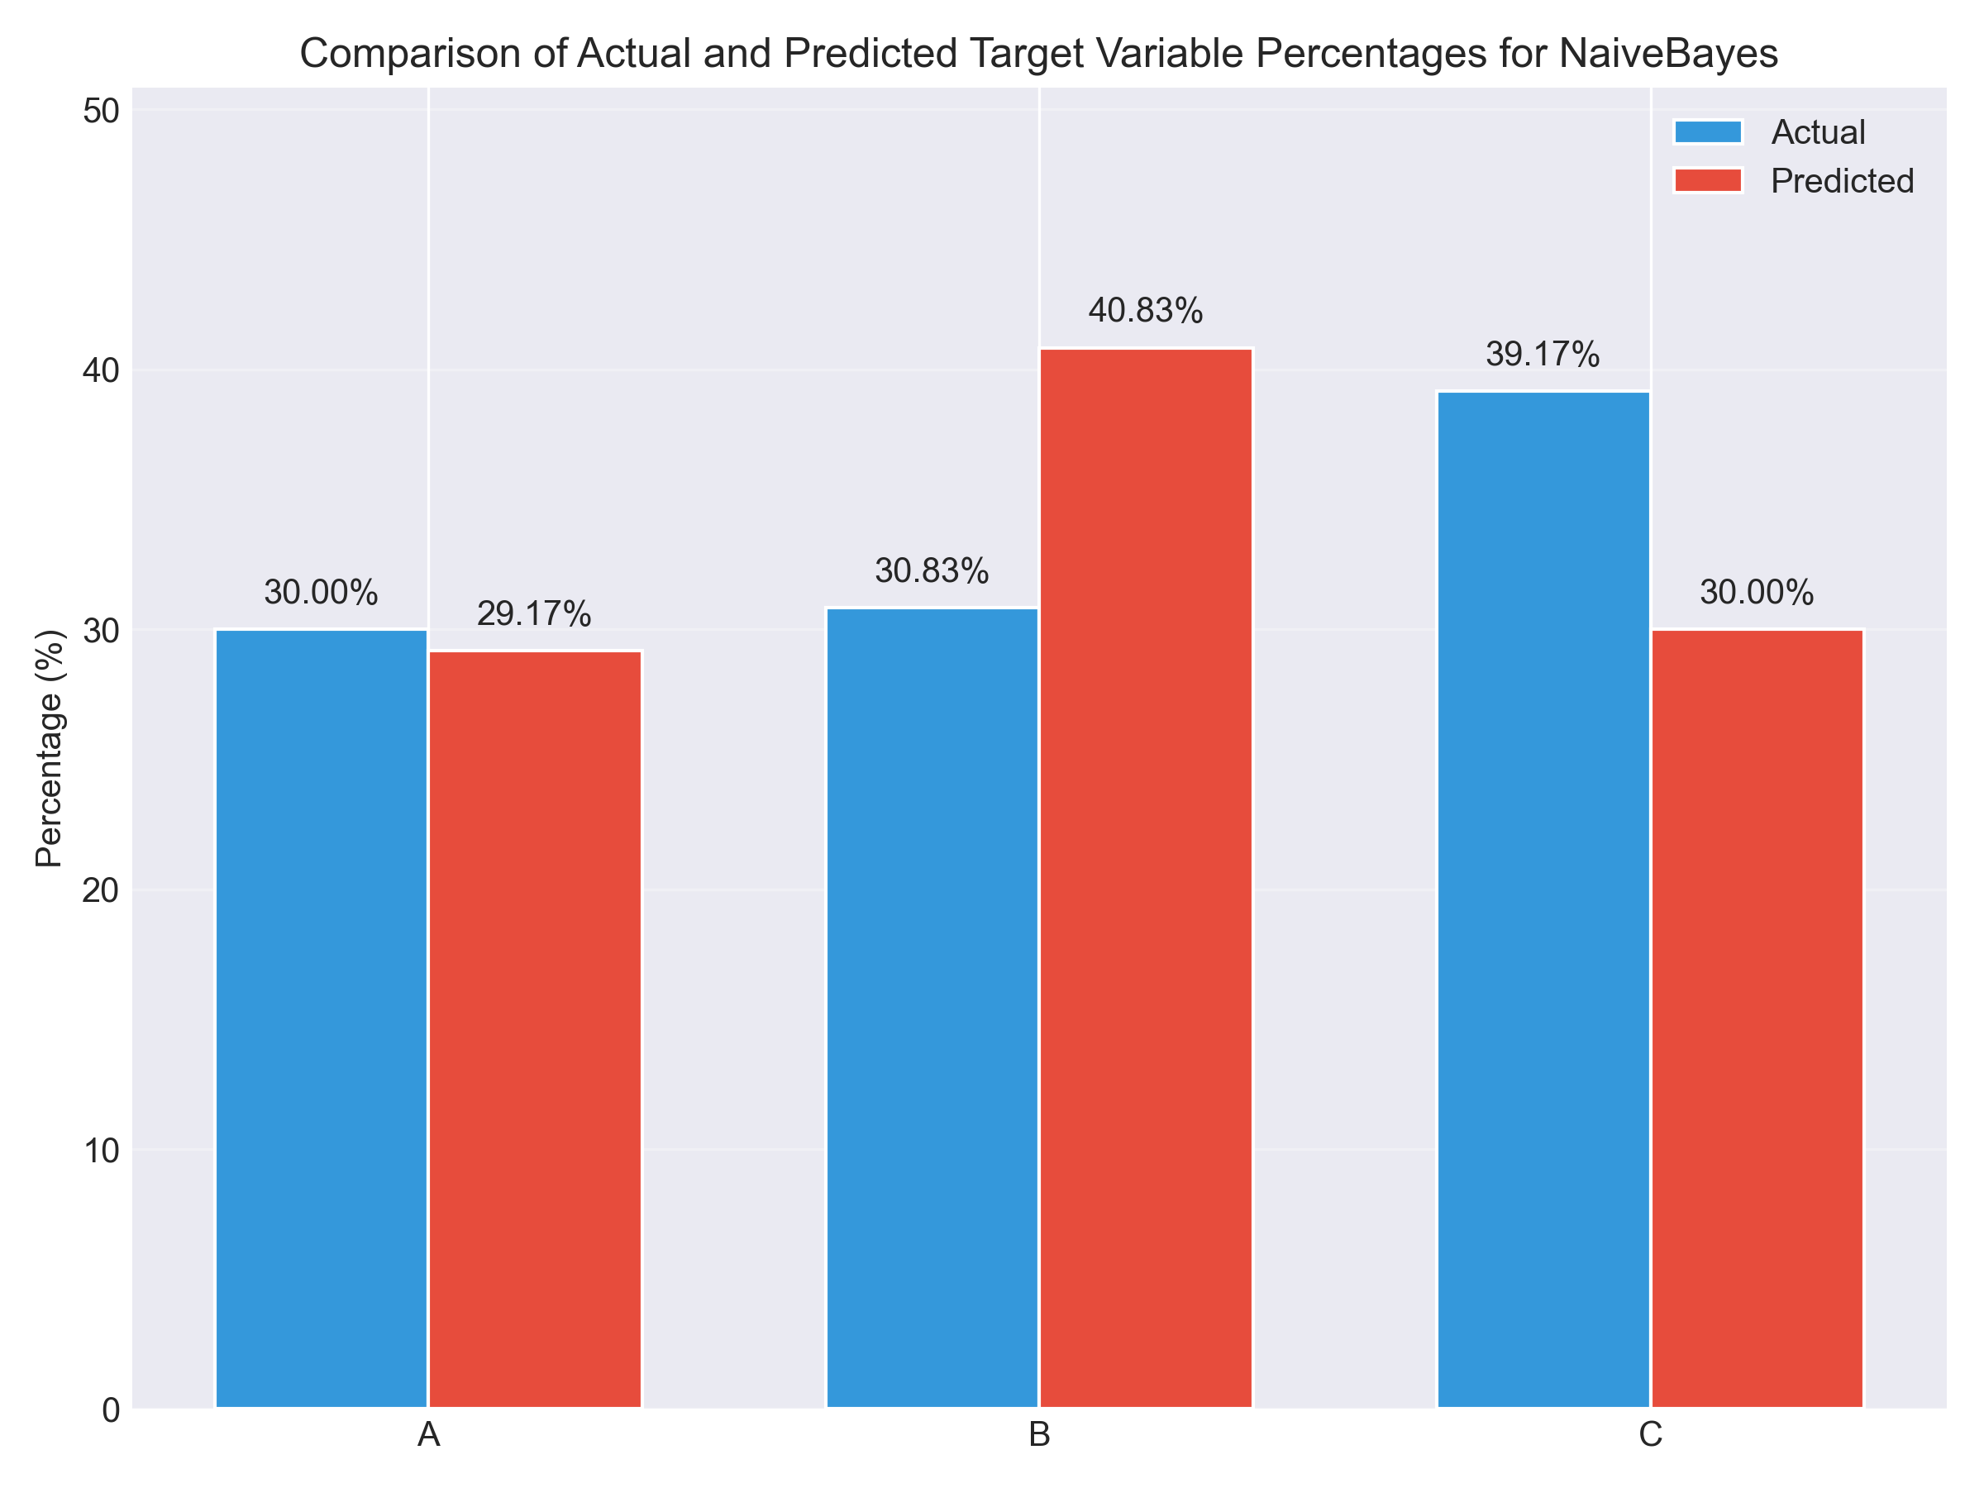
ACCURACY SCORE OF NAÏVE BAYES:
ACCURACY SCORES FROM BASE PAPER
ACCURACY SCORES FROM CODE
23

Slide 26
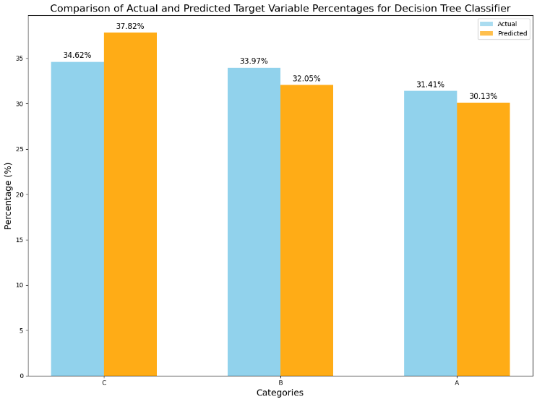
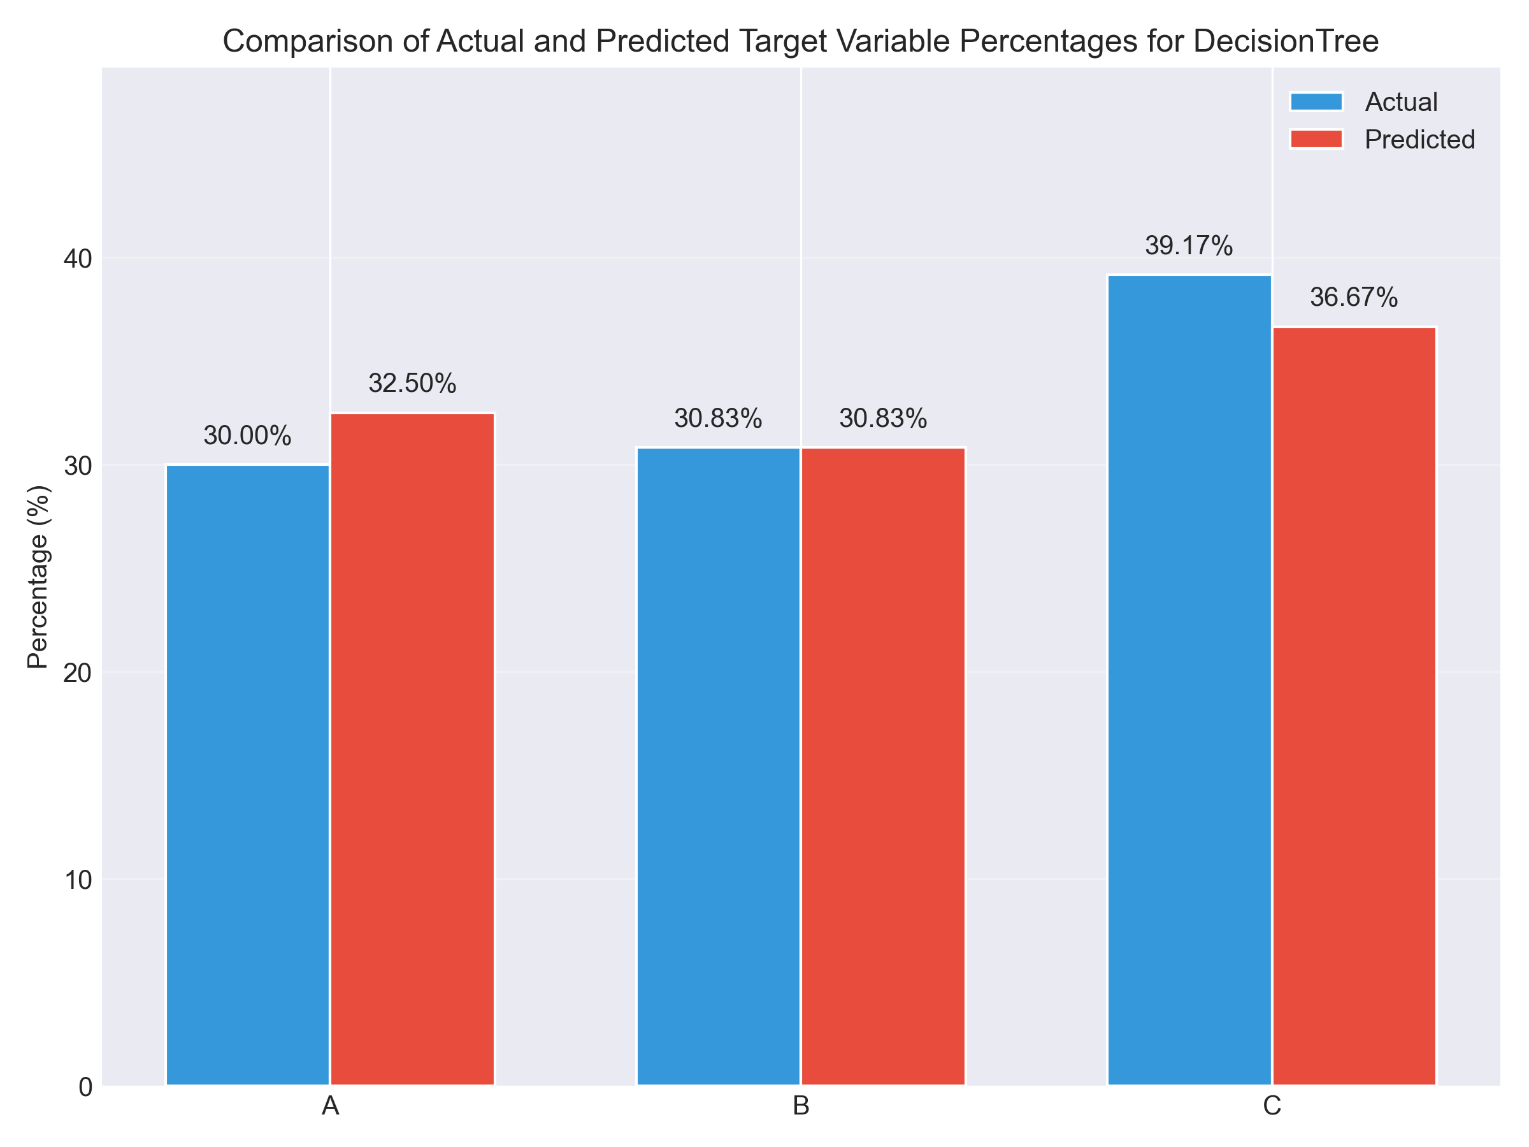
ACCURACY SCORE OF DECISION TREE:
ACCURACY SCORES FROM BASE PAPER
ACCURACY SCORES FROM CODE
24

Slide 27
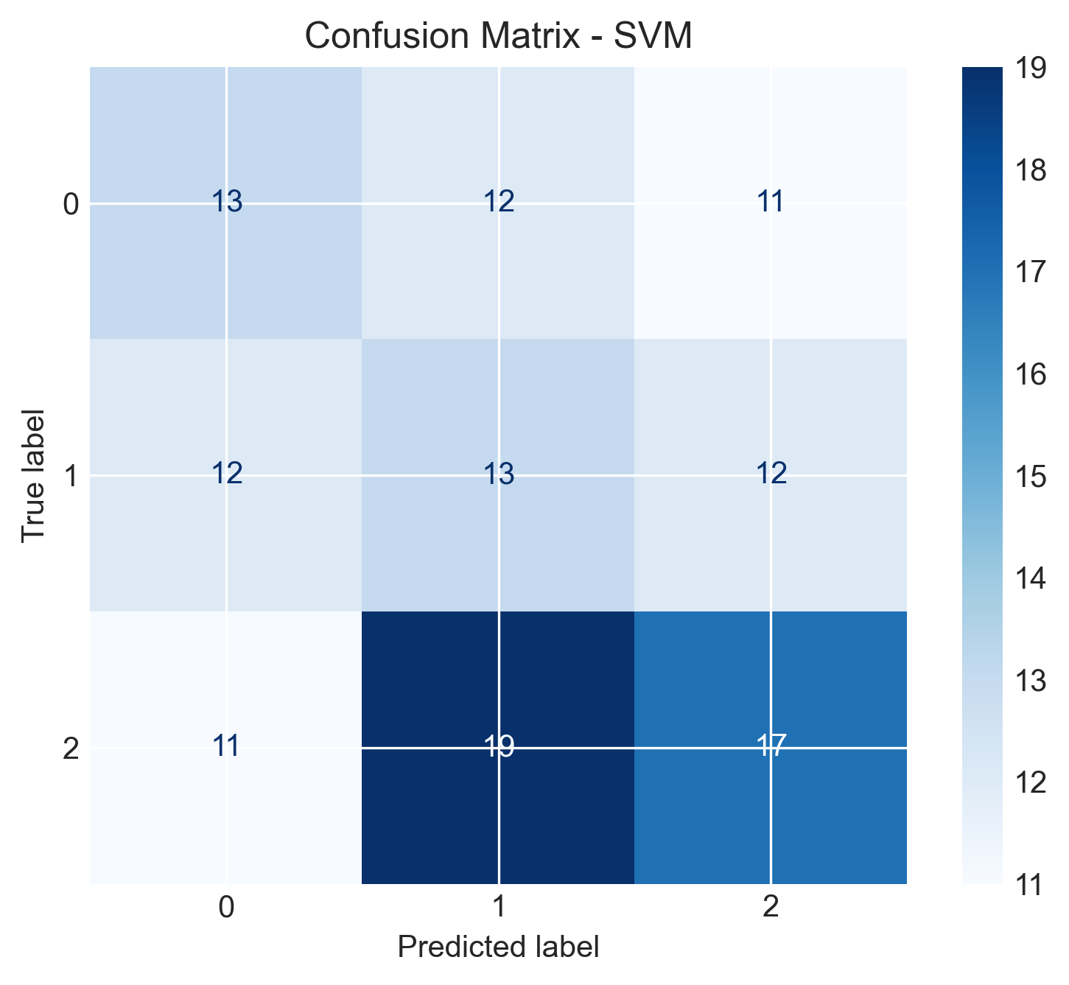
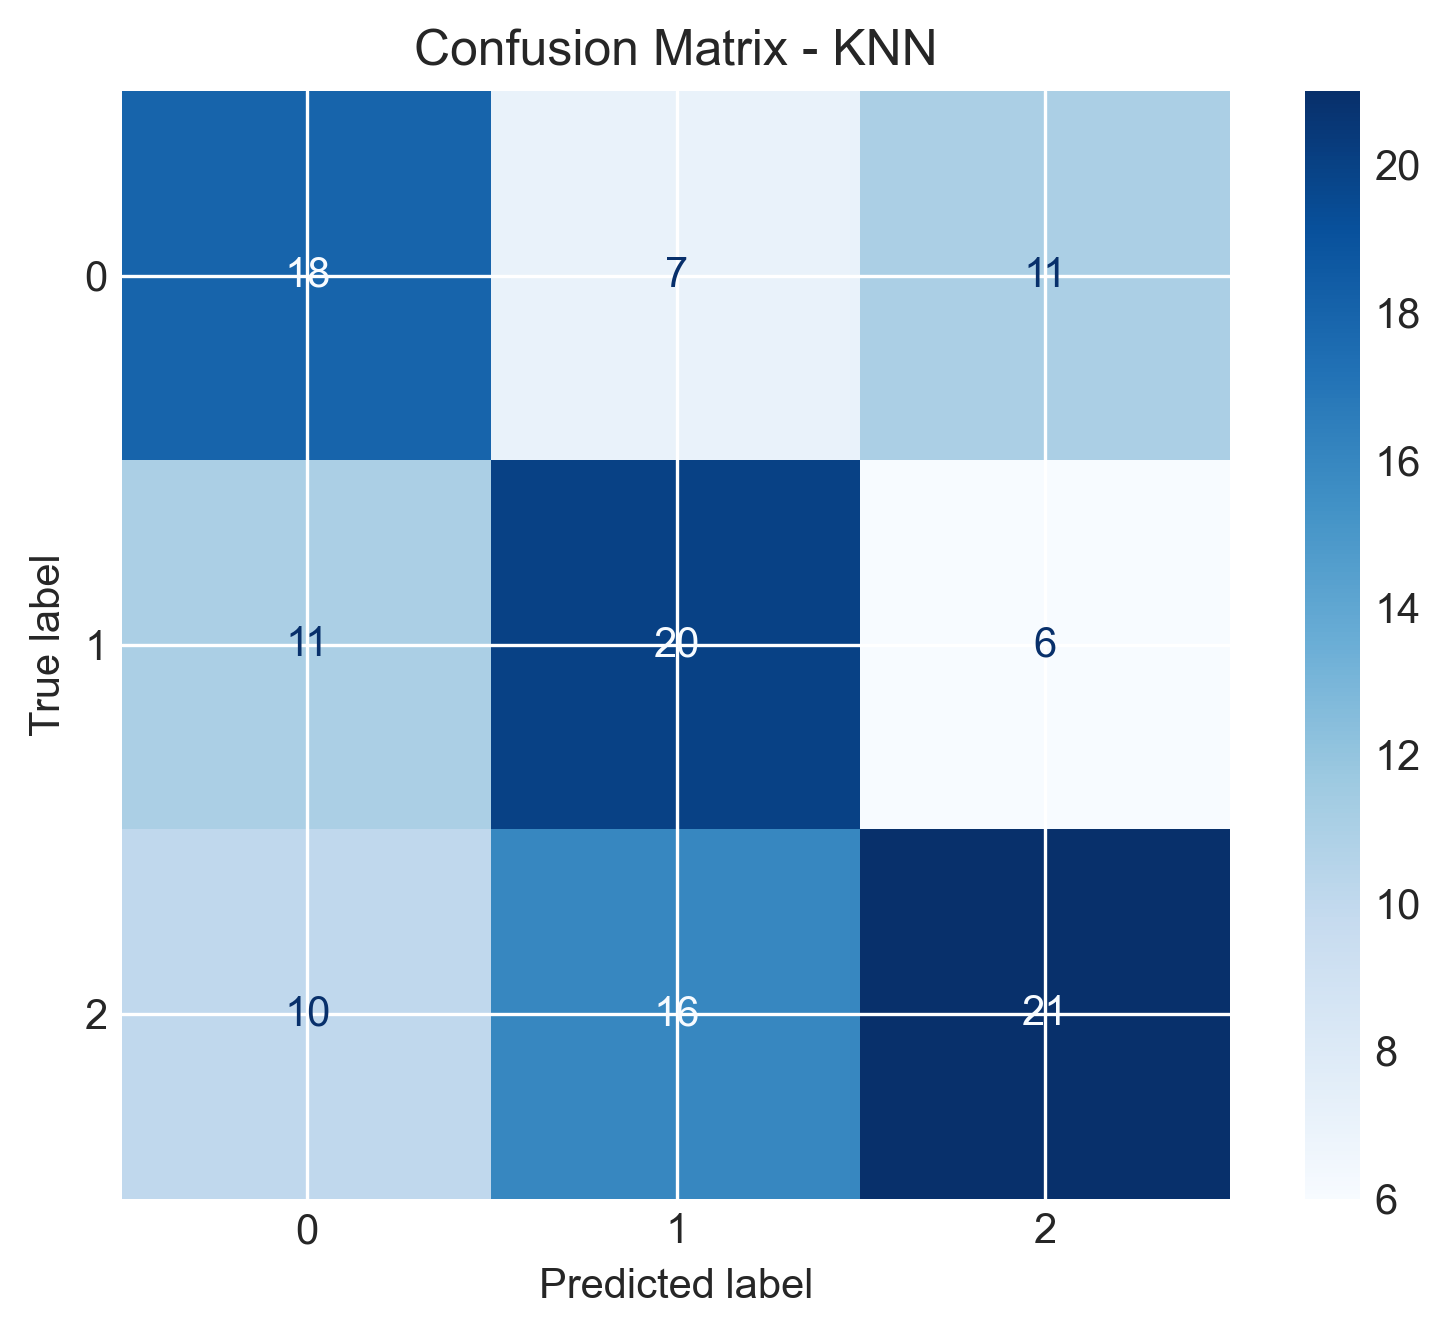
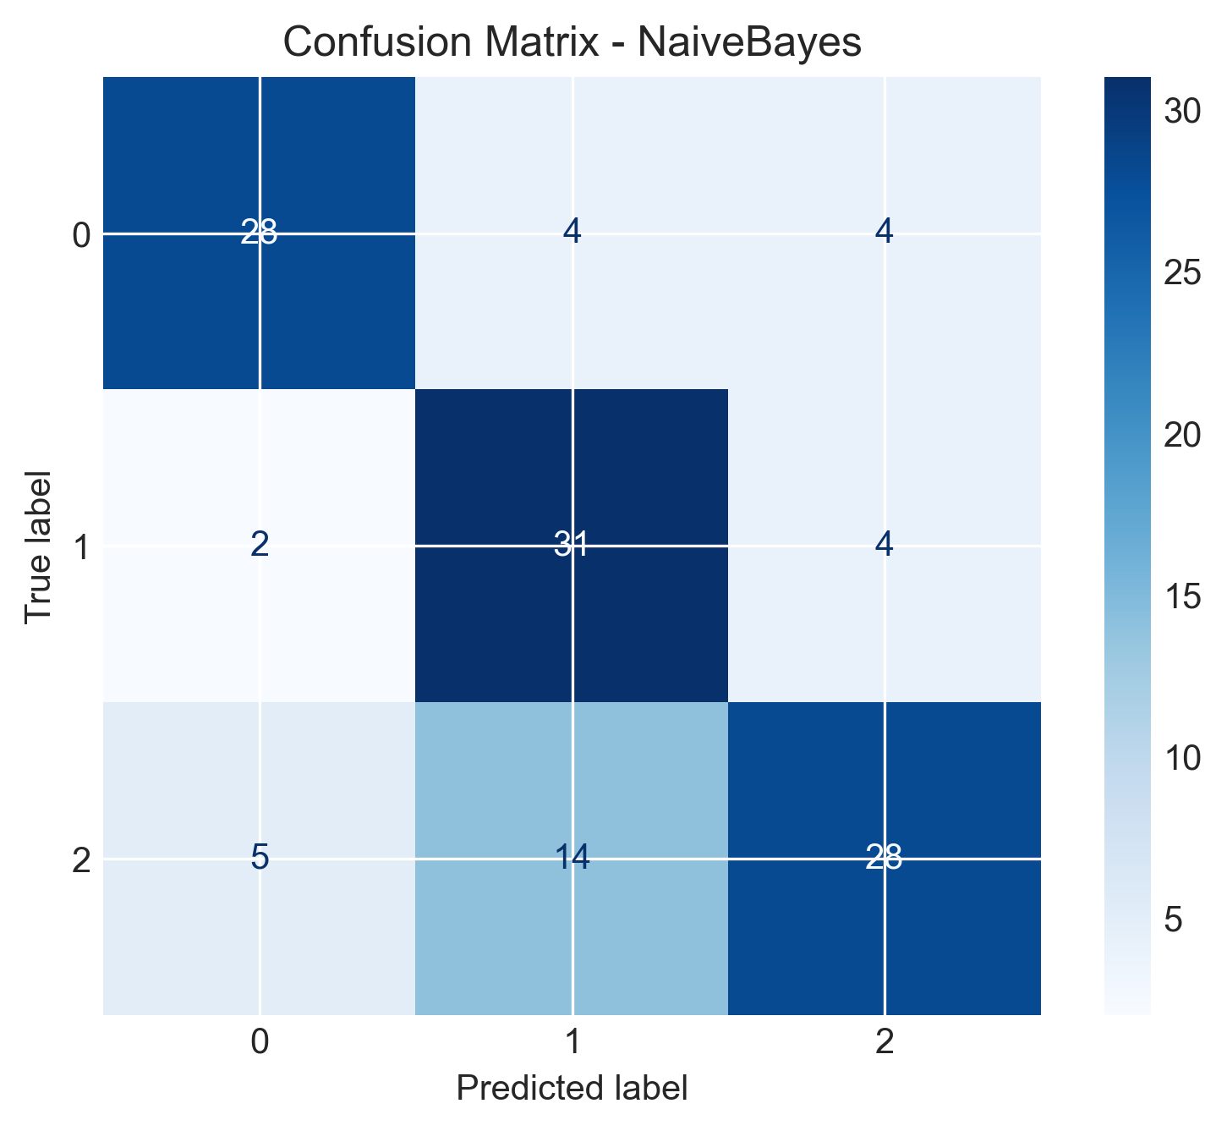
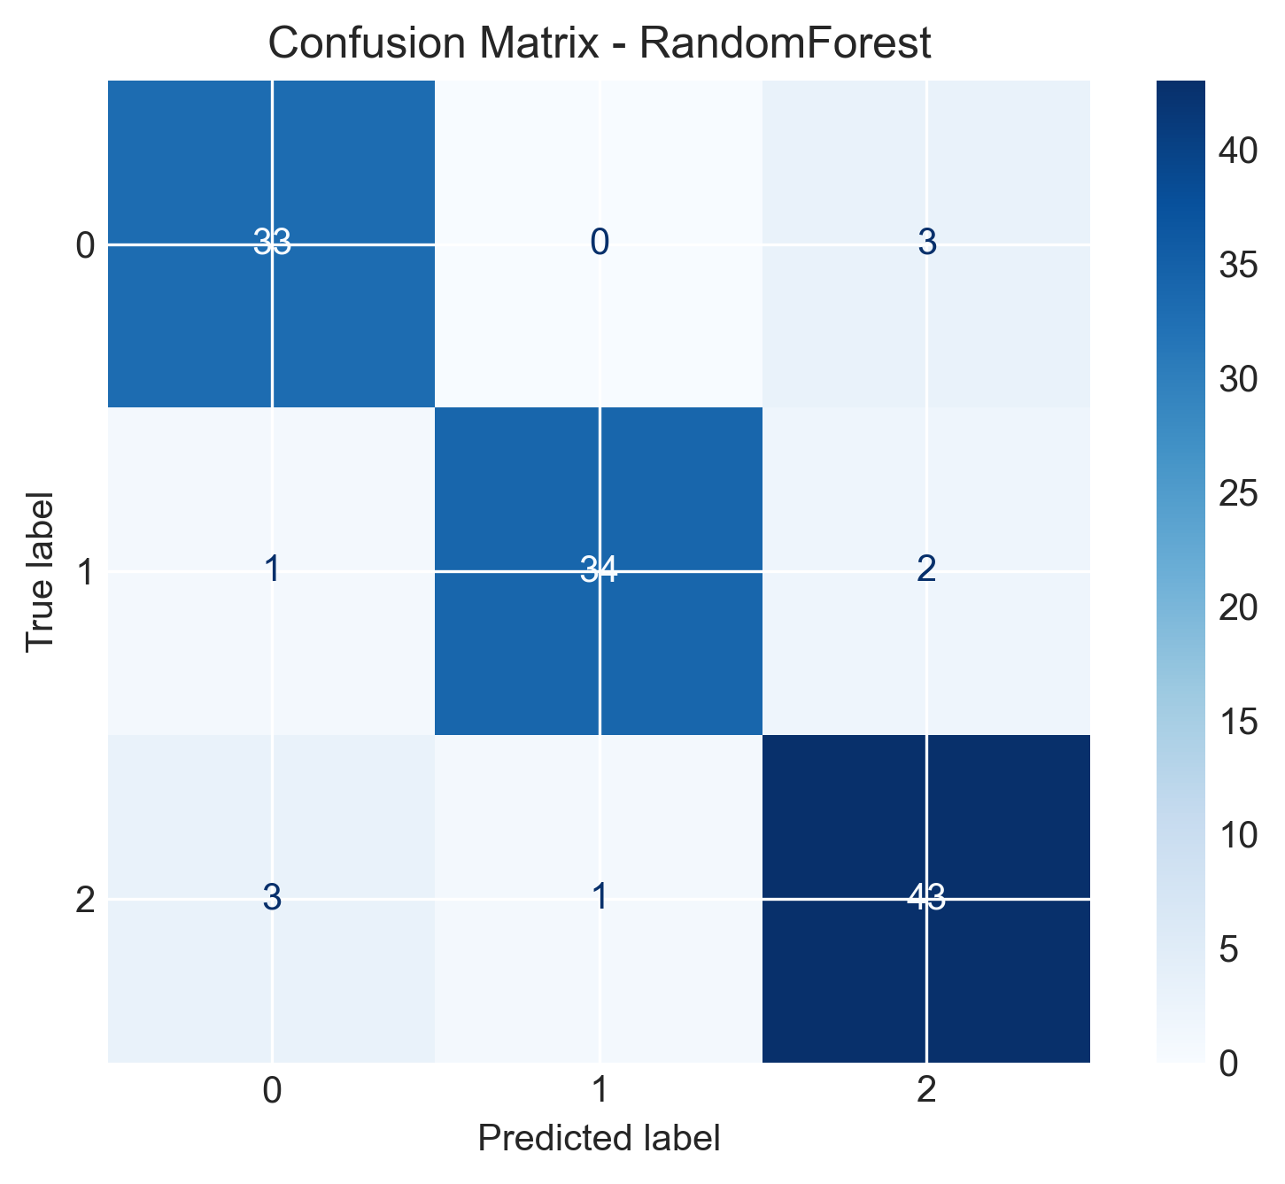
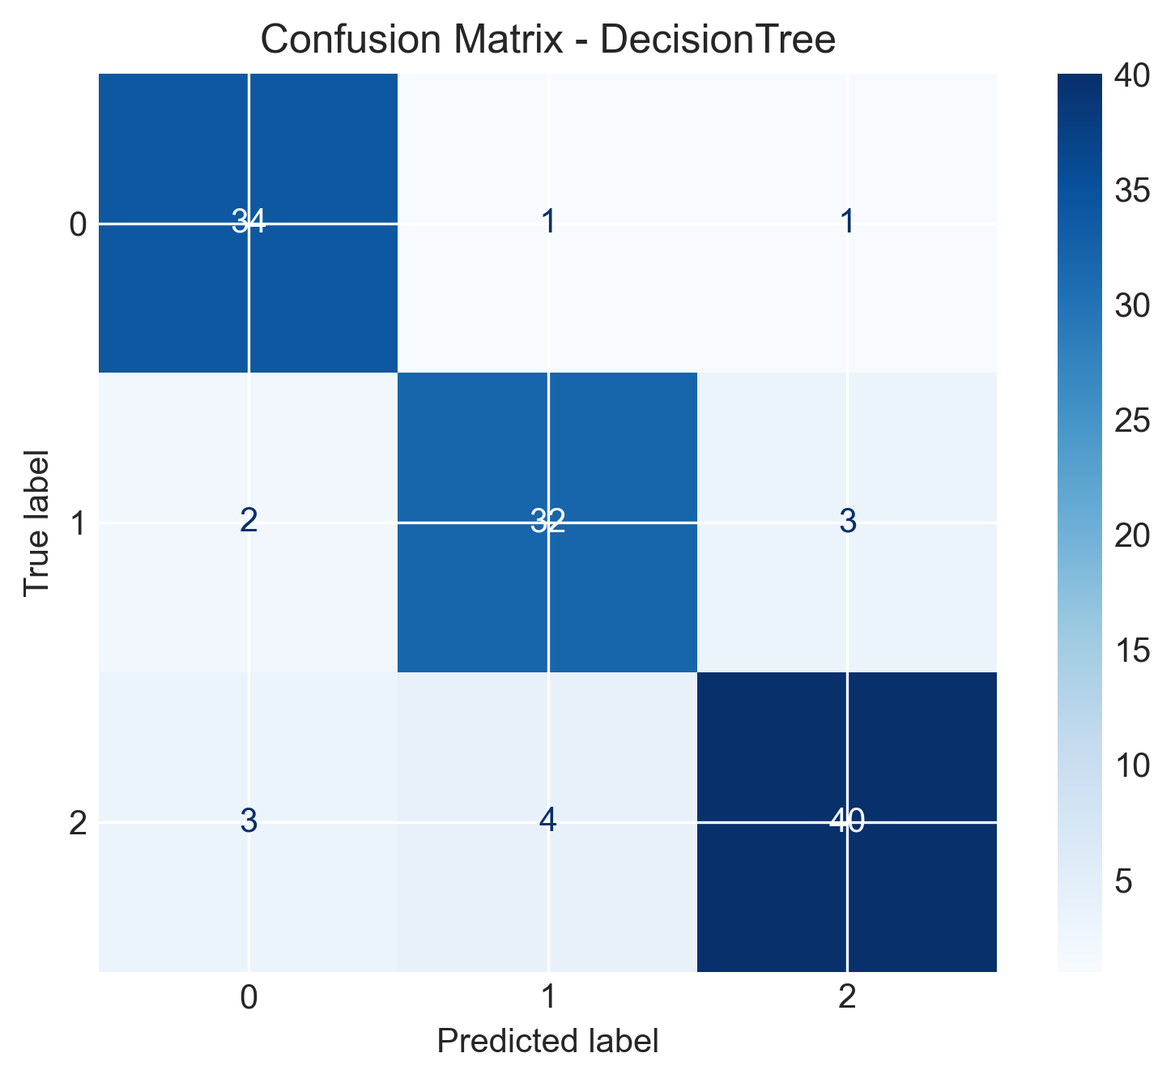
Confusion MAtrices
25

Slide 28
ADDITIONAL WORKS DONE
Additional Processing Applied Feature Selection for Naive Bayes:
SelectKBest(mutual_info_classif, k=int(0.7 * len(X_train.columns))) → Selects 70% of the most relevant features based on mutual information.
Feature Transformation : Power Transformer(method='yeo-johnson') → Applies a transformation to normalize feature distribution.
Handling Class Imbalance for All Models:SMOTE(random state=42) → Generates synthetic samples to balance the class distribution.
These hyperparameters were tuned using BayesianSearchCV with 5-fold cross-validation (cv=5), optimizing for accuracy (scoring='accuracy').
26

Slide 29
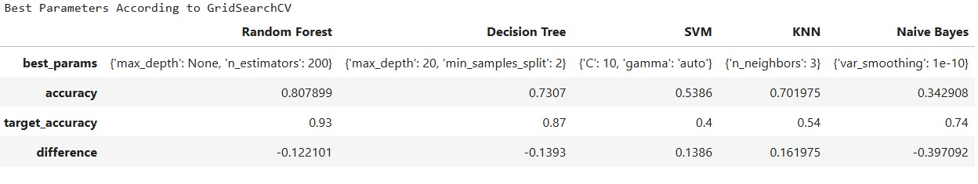
PARAMETERS ACCORDING TO GRIDSEARCH CV
27

Slide 30
OVERALL ANALYSIS:
The study focuses on optimizing classification performance using multiple machine learning models with hyperparameter tuning. Below is a summary of the key observations from the tuning and evaluation process:
Hyperparameter Tuning Impact
Random Forest: Increased tree depth and number of estimators improved accuracy, but excessive depth led to overfitting.
SVM: Choosing an optimal kernel and adjusting C and gamma helped balance bias and variance.
KNN: Fine-tuning the number of neighbors showed that lower values improved sensitivity but increased variance.
Decision Tree: Controlling max_depth and min_samples_split helped reduce overfitting.
Naïve Bayes: Var smoothing optimization led to better generalization on unseen data.
28

Slide 31
2. Performance Comparison & Overfitting Risks :
Models like Random Forest and SVM performed well but were prone to overfitting.
KNN and Decision Tree needed careful tuning to avoid bias-variance trade-off issues.
Naïve Bayes, despite being simple, showed competitive accuracy with feature selection and transformation.
3. Observations & Challenges :
SMOTE balancing helped, but oversampling could lead to synthetic bias in some cases.
Feature selection (SelectKBest) improved model performance, particularly for Naïve Bayes.
Power Transformation enhanced data distribution, improving classification accuracy.
Computation cost increased with hyperparameter tuning, especially for grid search on complex models.
29

Slide 32
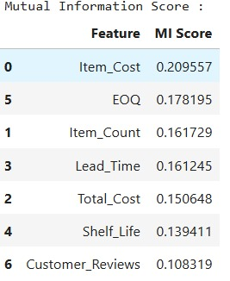
"Feature Importance Ranking Based on Mutual Information Scores for Inventory Classification"
Features with higher MI scores are typically more important for predicting the target variable, so they're prioritized when selecting features for a model.
Higher MI scores indicate stronger relationships between a feature and the target.
29

Slide 33
MILESTONES ACHIEVED
JAN 21 TO JAN 31
Topic and base paper finalization
30
JAN 21 TO JAN 31
Topic and base paper finalization
FEB 10 TO FEB 14
STUDY OF BASE PAPER
FEB 17 TO FEB 21
IMPLEMENTATION STAGE 1
~DATA PREPROCESSING
~IMPUTATION

Slide 34
MILESTONES ACHIEVED
JAN 21 TO JAN 31
Topic and base paper finalization
FEB 10 TO FEB 14
STUDY OF BASE PAPER
31
JAN 21 TO JAN 31
Topic and base paper finalization
FEB 10 TO FEB 14
STUDY OF BASE PAPER
FEB 17 TO FEB 21
IMPLEMENTATION STAGE 1
~DATA PREPROCESSING
~IMPUTATION

Slide 35
MILESTONES ACHIEVED
JAN 21 TO JAN 31
Topic and base paper finalization
FEB 10 TO FEB 14
STUDY OF BASE PAPER
FEB 17 TO FEB 21
IMPLEMENTATION STAGE 1
~DATA PREPROCESSING
~IMPUTATION
32
MARCH 16 TO MARCH 31
IMPLEMENTING ADDITIONAL FEATURES FOR OPTIMISATION
MARCH 01 TO MARCH 15
IMPLEMENTING CORRECTIONS FROM MID EVALUATION
FEB 21 TO FEB 28
IMPLEMENTATION OF STAGE 2
~MODEL BUILDING
~PAPER IMPLEMENTATION

Slide 36
MILESTONES ACHIEVED
FEB 21 TO FEB 28
IMPLEMENTATION OF STAGE 2
~MODEL BUILDING
~PAPER IMPLEMENTATION
33
MARCH 16 TO MARCH 31
IMPLEMENTING ADDITIONAL FEATURES FOR OPTIMISATION
MARCH 01 TO MARCH 15
IMPLEMENTING CORRECTIONS FROM MID EVALUATION
FEB 21 TO FEB 28
IMPLEMENTATION OF STAGE 2
~MODEL BUILDING
~PAPER IMPLEMENTATION

Slide 37
MILESTONES ACHIEVED
MARCH 01 TO MARCH 15
IMPLEMENTING CORRECTIONS FROM MID EVALUATION
FEB 21 TO FEB 28
IMPLEMENTATION OF STAGE 2
~MODEL BUILDING
~PAPER IMPLEMENTATION
34
MARCH 16 TO MARCH 31
IMPLEMENTING ADDITIONAL FEATURES FOR OPTIMISATION
MARCH 01 TO MARCH 15
IMPLEMENTING CORRECTIONS FROM MID EVALUATION
FEB 21 TO FEB 28
IMPLEMENTATION OF STAGE 2
~MODEL BUILDING
~PAPER IMPLEMENTATION

Slide 38
MILESTONES ACHIEVED
MARCH 16 TO MARCH 31
IMPLEMENTING ADDITIONAL FEATURES FOR OPTIMISATION
MARCH 01 TO MARCH 15
IMPLEMENTING CORRECTIONS FROM MID EVALUATION
FEB 21 TO FEB 28
IMPLEMENTATION OF STAGE 2
~MODEL BUILDING
~PAPER IMPLEMENTATION
35
MARCH 16 TO MARCH 31
IMPLEMENTING ADDITIONAL FEATURES FOR OPTIMISATION
MARCH 01 TO MARCH 15
IMPLEMENTING CORRECTIONS FROM MID EVALUATION
FEB 21 TO FEB 28
IMPLEMENTATION OF STAGE 2
~MODEL BUILDING
~PAPER IMPLEMENTATION

Slide 39
SUMMARY :
The paper addresses the increasing reliance of industries on efficient inventory management, logistics, and supply chain operations.
It focuses on the application of Machine Learning (ML) techniques within the ABC Inventory Classification methodology.
The study compares five ML algorithms: Decision Tree Algorithm, Support Vector Machines (SVM), Random Forest Classifier, Naïve Bayes Classifier, and K-nearest neighbors (KNN).
36

Slide 40
SUMMARY :
The research aims to improve the effectiveness, precision, and financial performance of inventory management practices by leveraging ML.
The study uses a classification model based on ABC (Always Better Control) Classification.
The trained ML model is applied in real-time SKU classification to facilitate efficient inventory management.
37

Slide 41
REFERENCES:
Shreyas Bailkar et al., "Smart Inventory Optimization using ML Algorithms," IEEE IDCIoT-2024 Note: The direct link to this paper is not available in the provided search results. However, you can search for the paper on IEEE Xplore or contact your institution's library for access.
Krishnakumar S. et al., "Medi Stock: Medical Inventory Management System," IEEE ICESC-2023 Note: The direct link to this paper is not available in the provided search results. Please search for the paper on IEEE Xplore or consult your institution's library for access.
A. Mishra et al., "IoT & ML-Based Inventory Management," IEEE CICT-2020 Note: The direct link to this paper is not available in the provided search results. Please search for the paper on IEEE Xplore or consult your institution's library for access.
Srinivas Kedarisetty et al., "Neural Networks for Inventory Prediction," IEEE ICCES-2022 Note: The direct link to this paper is not available in the provided search results. Please search for the paper on IEEE Xplore or consult your institution's library for access.
Bhamidipati Raviteja et al., "SCM Optimization using ML," IEEE ICECAA-2022 Note: The direct link to this paper is not available in the provided search results. Please search for the paper on IEEE Xplore or consult your institution's library for access.
38

